Slide 1
Data Conservation in Action - Engaging the community in the DataAtRisk.org Data Commons
Ruth Duerr, Katie Mika, Denise Hills, Joan Saez, Andrew Magill and the rest of the team!

Slide 2
Vision
The At-Risk Data Commons (DataAtRisk.org) is a website and associated non-profit organization that connects people with data at risk to volunteers, data experts, and additional resources.
A Match.com for data at risk and orphaned or surrendered data.
Not an archive, possibly a foster home!

Slide 3
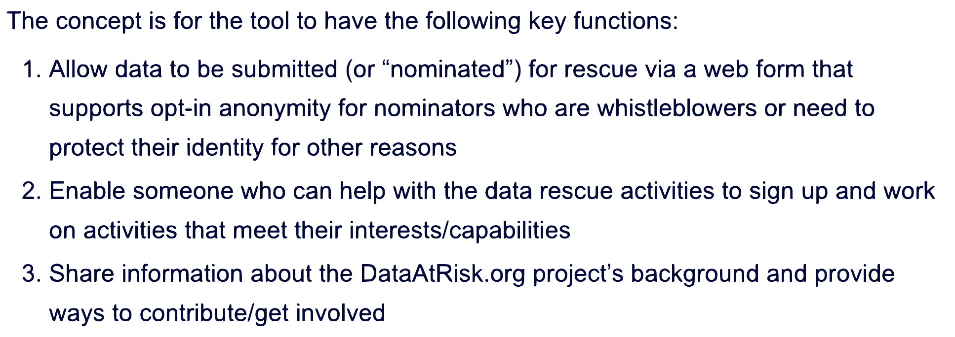
Two components - an organization and tools to manage requests
Tooling Concepts:
Data owners, managers, or others nominate assets for targeted preservation action by data management experts and community volunteers, and create a community of Data Heroes who ensure the longevity of data products essential to quality research.

Slide 4
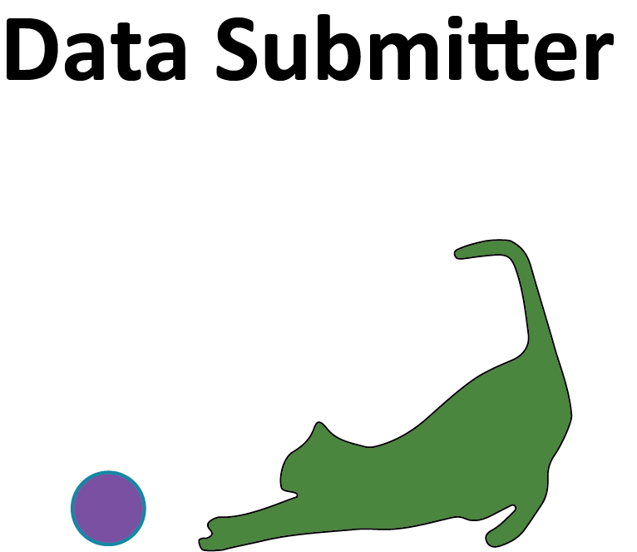


Organizational Participant Roles
Submitter - A registered user who submits a data rescue request (can be anonymous)
Advocate - A facilitator who processes submissions, links them with Data Heroes, and confirms completion of tasks with the Submitter (and may provide additional support during the process) (can be anonymous)
Hero - A registered user who signs on to help with data rescue tasks. Heroes may have data sets sent to them based on applicable skills, or may choose from a list of available submissions (can not be anonymous)

Slide 5
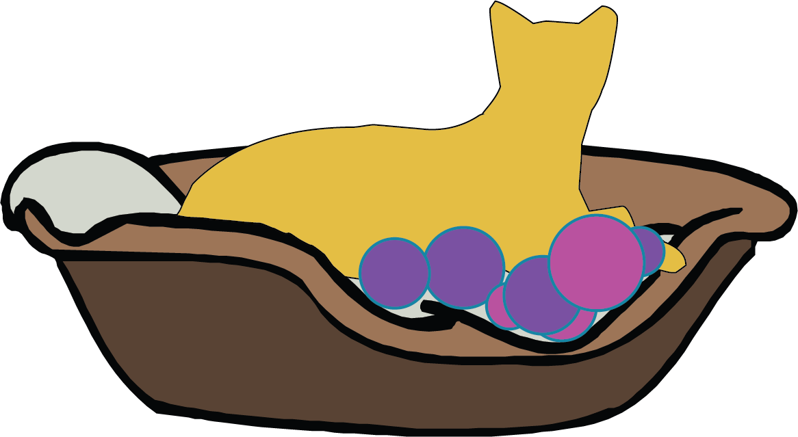
Envisioned High Level Process
Advocates assesses, sorts, splits into tasks
Request submitted
Submitter approves
Heroes search, select, work
Advocates checks, shares
Outcomes archived, data informs future!

Slide 6
High Level Implementation Status
Advocates assesses, sorts, splits into tasks
Request submitted
Prototypes implemented
Submitter approves
Heroes search, select, work
Advocates checks, shares
Outcomes archived, data informs future!

Slide 7
Design and Development Status
Implementation and hosting by CloudBirst Inc.
Science Gateways Community Institute support
  Attended a week long Bootcamp last year
  Quarter time technical development support (thanks Andrew!)
  Security and UI/UX work upcoming
  Sustainability, on boarding processes, and volunteer management in process
Weekly team meetings (feel free to attend)
  Technical Meeting Alternate Wednesday’s at 4 pm Mountain
  Business/Operations Meeting Alternate Monday’s at noon mountain

Slide 8
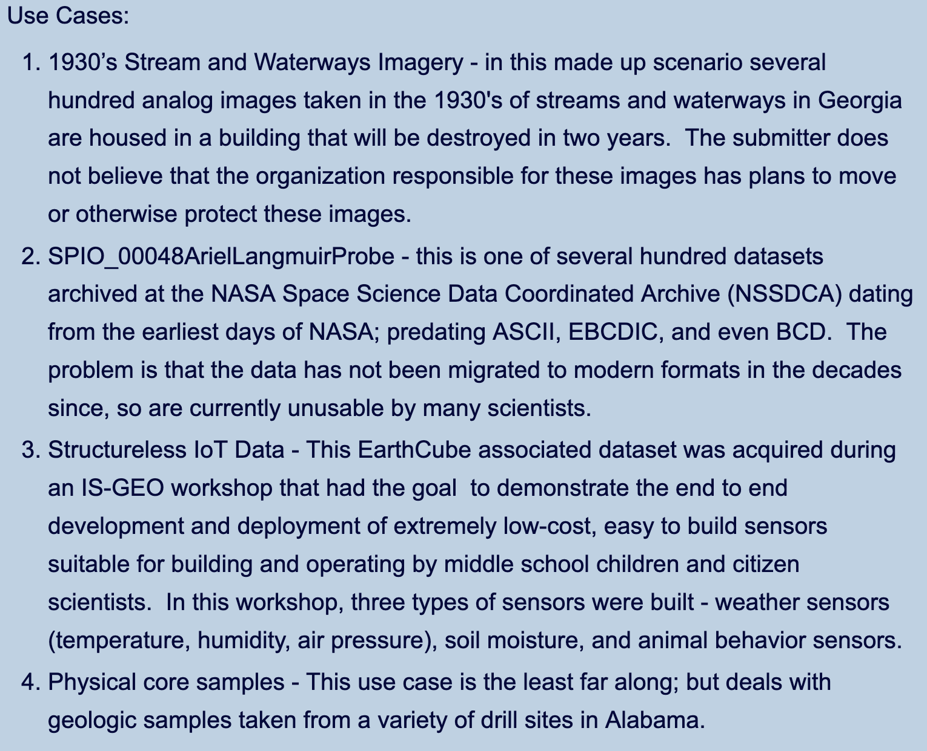
Use Cases

Slide 9
SGCI Technical Support:
Milestone #1: High Level Specs: The document should describe at a high level all the requirements for development of the site.
Milestone #2 Low Level Specs: The low level specification document should provide detail to each of the high level specifications, listing and describing individual component tasks and requirements
Milestone #3 Data Model: The model should describe the database schema in sufficient detail to directly build the schema
Milestone #4 Form Specification: The form specifications should describe the input forms in sufficient detail to directly design the web forms

Slide 10
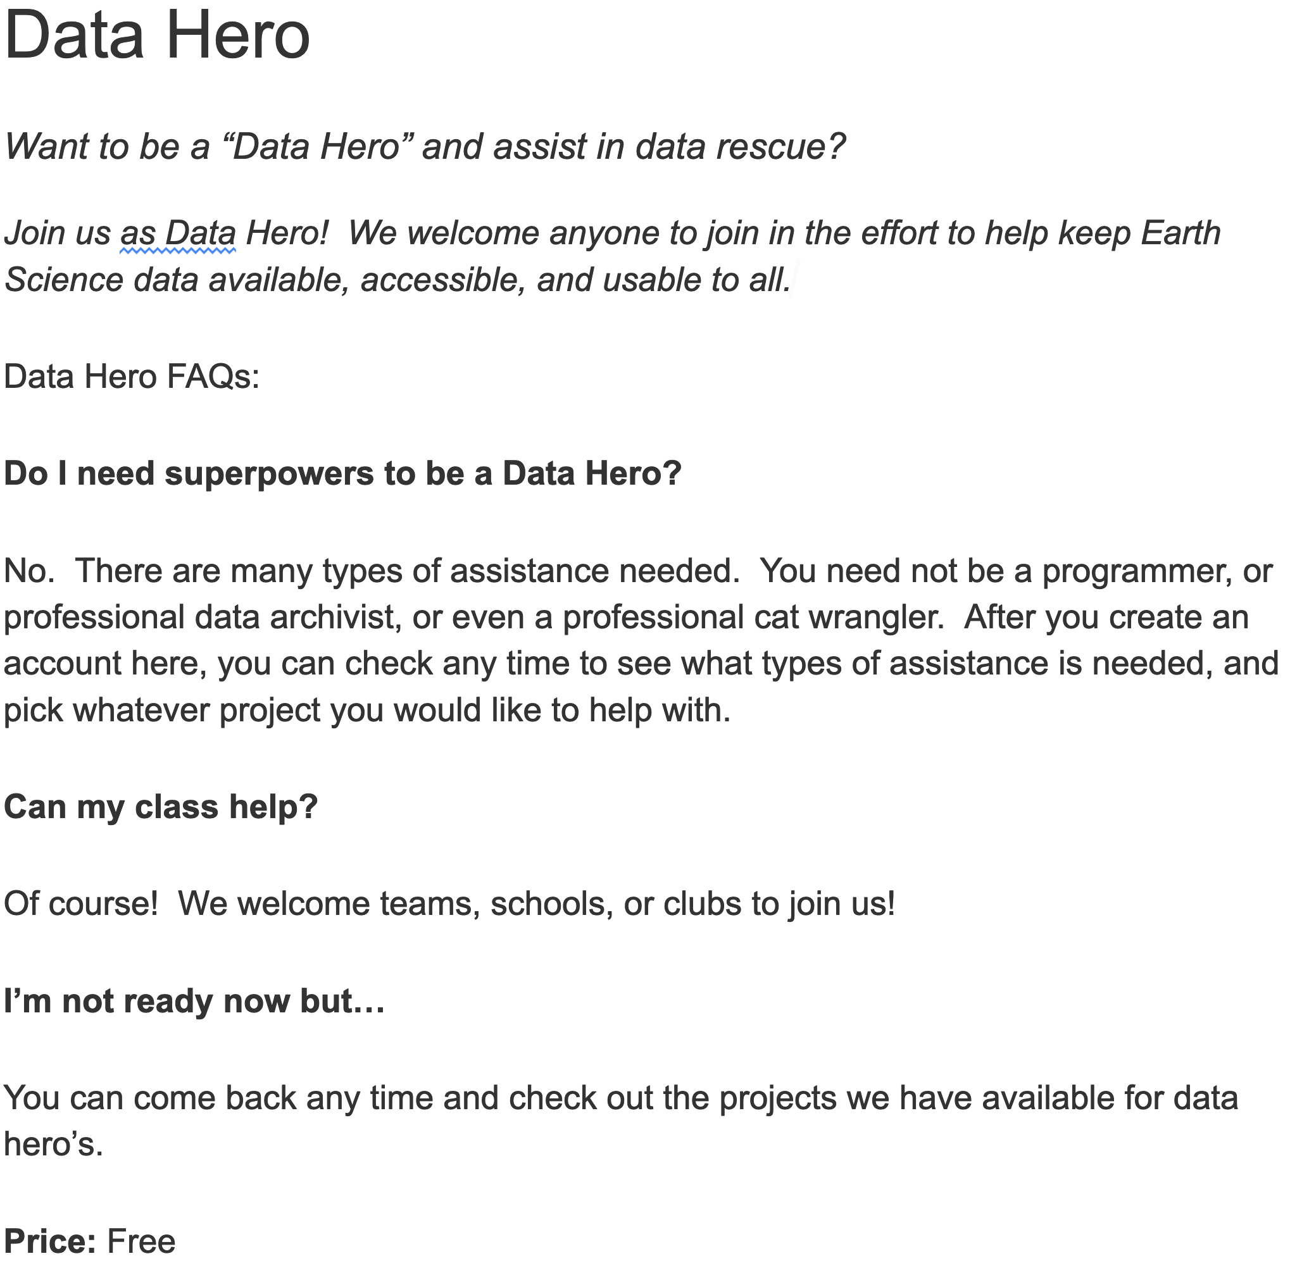

Slide 11
SGCI Business Support: Milestones
MILESTONE #1 - Sustainability Model
  Success: Define methods for revenue/funding
MILESTONE #2 - Onboarding Process
  Success: Clearly defined process for onboarding heroes, advocates, submitters
MILESTONE #3 - Volunteer Management Plan
  Success: Create management process and engagement plans for volunteers

Slide 12
Stakeholder Value Propositions
Repository/Data Managers - The At-Risk Data Commons will estimate actual costs and provide skilled volunteer labor to fill the resource gaps of Repository and Data Managers in order to make their at-risk data available in modern accessible ways.
Repository and Data Librarians - The At-Risk Data Commons will allow Institutional Repository and Data Librarians to ingest data that is more FAIR-aligned by providing skilled volunteer data and metadata curation services.
Data literacy educators (e.g., professionals at I-Schools and other organizations with data literacy missions) - The At-Risk Data Commons will provide practical training opportunities for future data professionals.
Researchers (Submitter) - The At-Risk Data Commons will assist researchers find and deposit their data into the best available repository for that data, and provide practical training opportunities for those interested in improving their own data practices.

Slide 13
Stakeholder Value Propositions
Data Heroes
  The At-Risk Data Commons will improve the science enterprise (and thereby all of humanity) by providing guidance to an activist network of data experts and volunteers to complete a variety of concrete and achievable data tasks to make data sets more useful and accessible.
  The At-Risk Data Commons will provide practical training opportunities for those interested in improving their own data practices as well as future data professionals.
At-Risk Data Commons Organization members - The At-Risk Data Commons will improve the science enterprise (and thereby all of humanity) by providing training, guidance, and oversight to a network of data experts and volunteers, and computerized matching for data sets needing a permanent archival home.

Slide 14
Contact us!
DataAtRisk.org - use the contact us button or sign up!
If you would like to actively participate please join the data_nomination_tool@googlegroups.com
Will be establishing a newsletter in the near future - updates a couple of times a year - if interested please provide name/email to ruth
or for more information/discussion you could mail ruth.duerr3 at gmail

